Slide 1
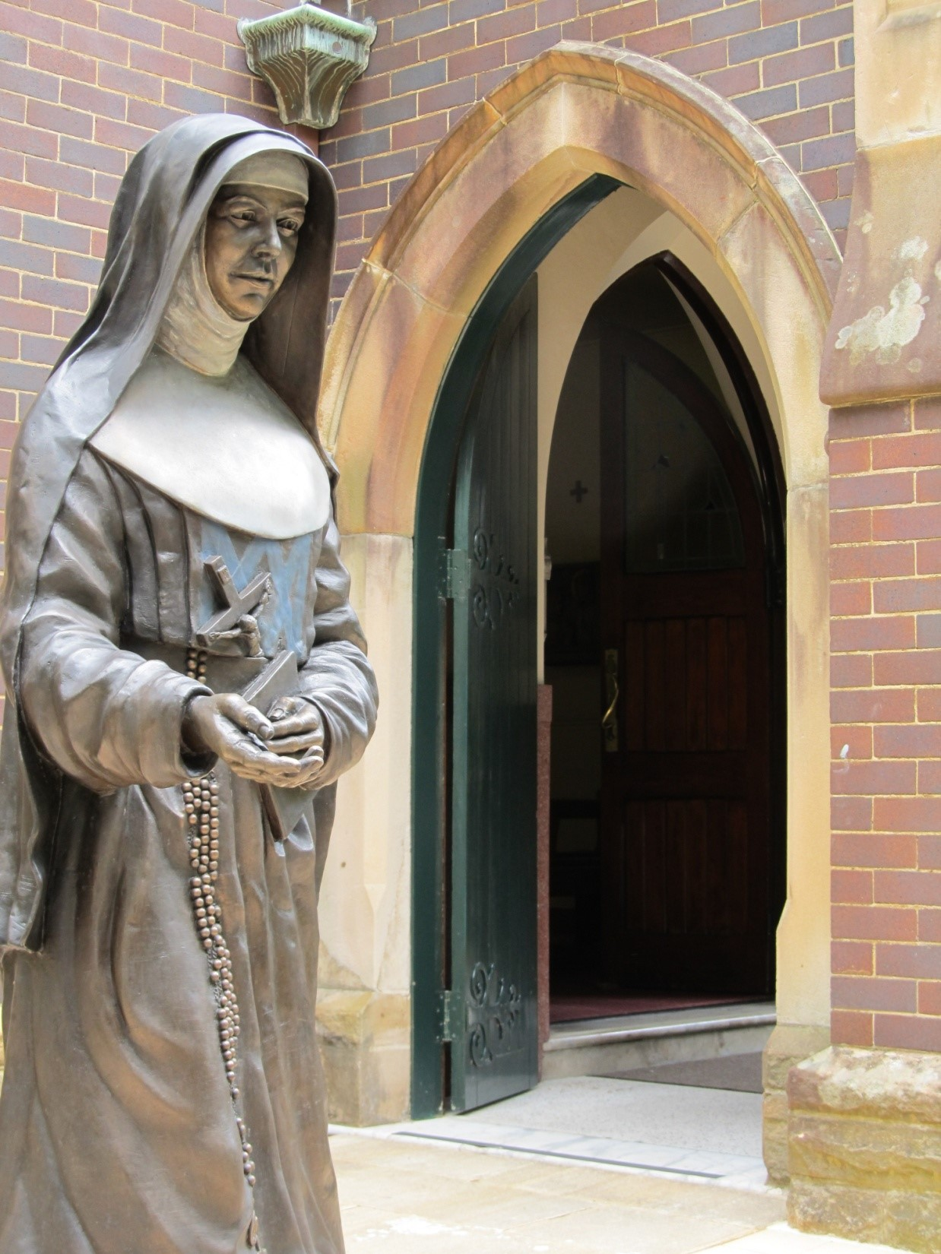
Tonight we enter into the
Great Three Days or Easter Triduum
Holy Thursday – the Lord’s Supper
Good Friday – the Lord’s Passion
Easter – the Resurrection.
These days invite us
into a time of quiet and reflection.
The reflections are such
that you can take your own time
as you pray with them.

Slide 2
HOLY THURSDAY
REFLECTION

Slide 3
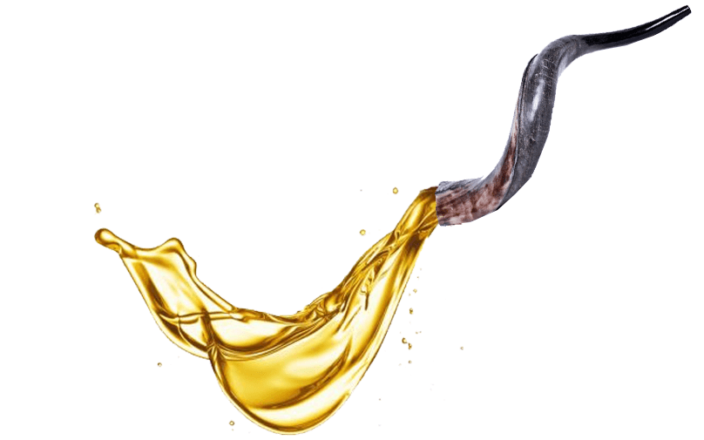
OIL OF THE SICK
Blessed and used to bring consolation and healing
to all who suffer.
Pause and pray for those you know who are suffering and in need of healing.

Slide 4
OIL OF CATECHUMENS
Blessed and used to strengthen our catechumens
in preparation for their Baptism at the Easter Vigil
and throughout the coming year,
and for all who are to be baptised.
Pause and pray for all whose Baptism has been postponed.

Slide 5
OIL OF CHRISM
Consecrated and a sign of life and salvation, this oil will be used
to anoint the newly Baptised,
to confirm Christians
and encourage their witness to faith,
and to preserve those who are ordained
for their work of sanctifying.
Pause and pray for those
who will be Baptised,
Confirmed and Ordained.

Slide 6
WASHING
OF
FEET

Slide 7
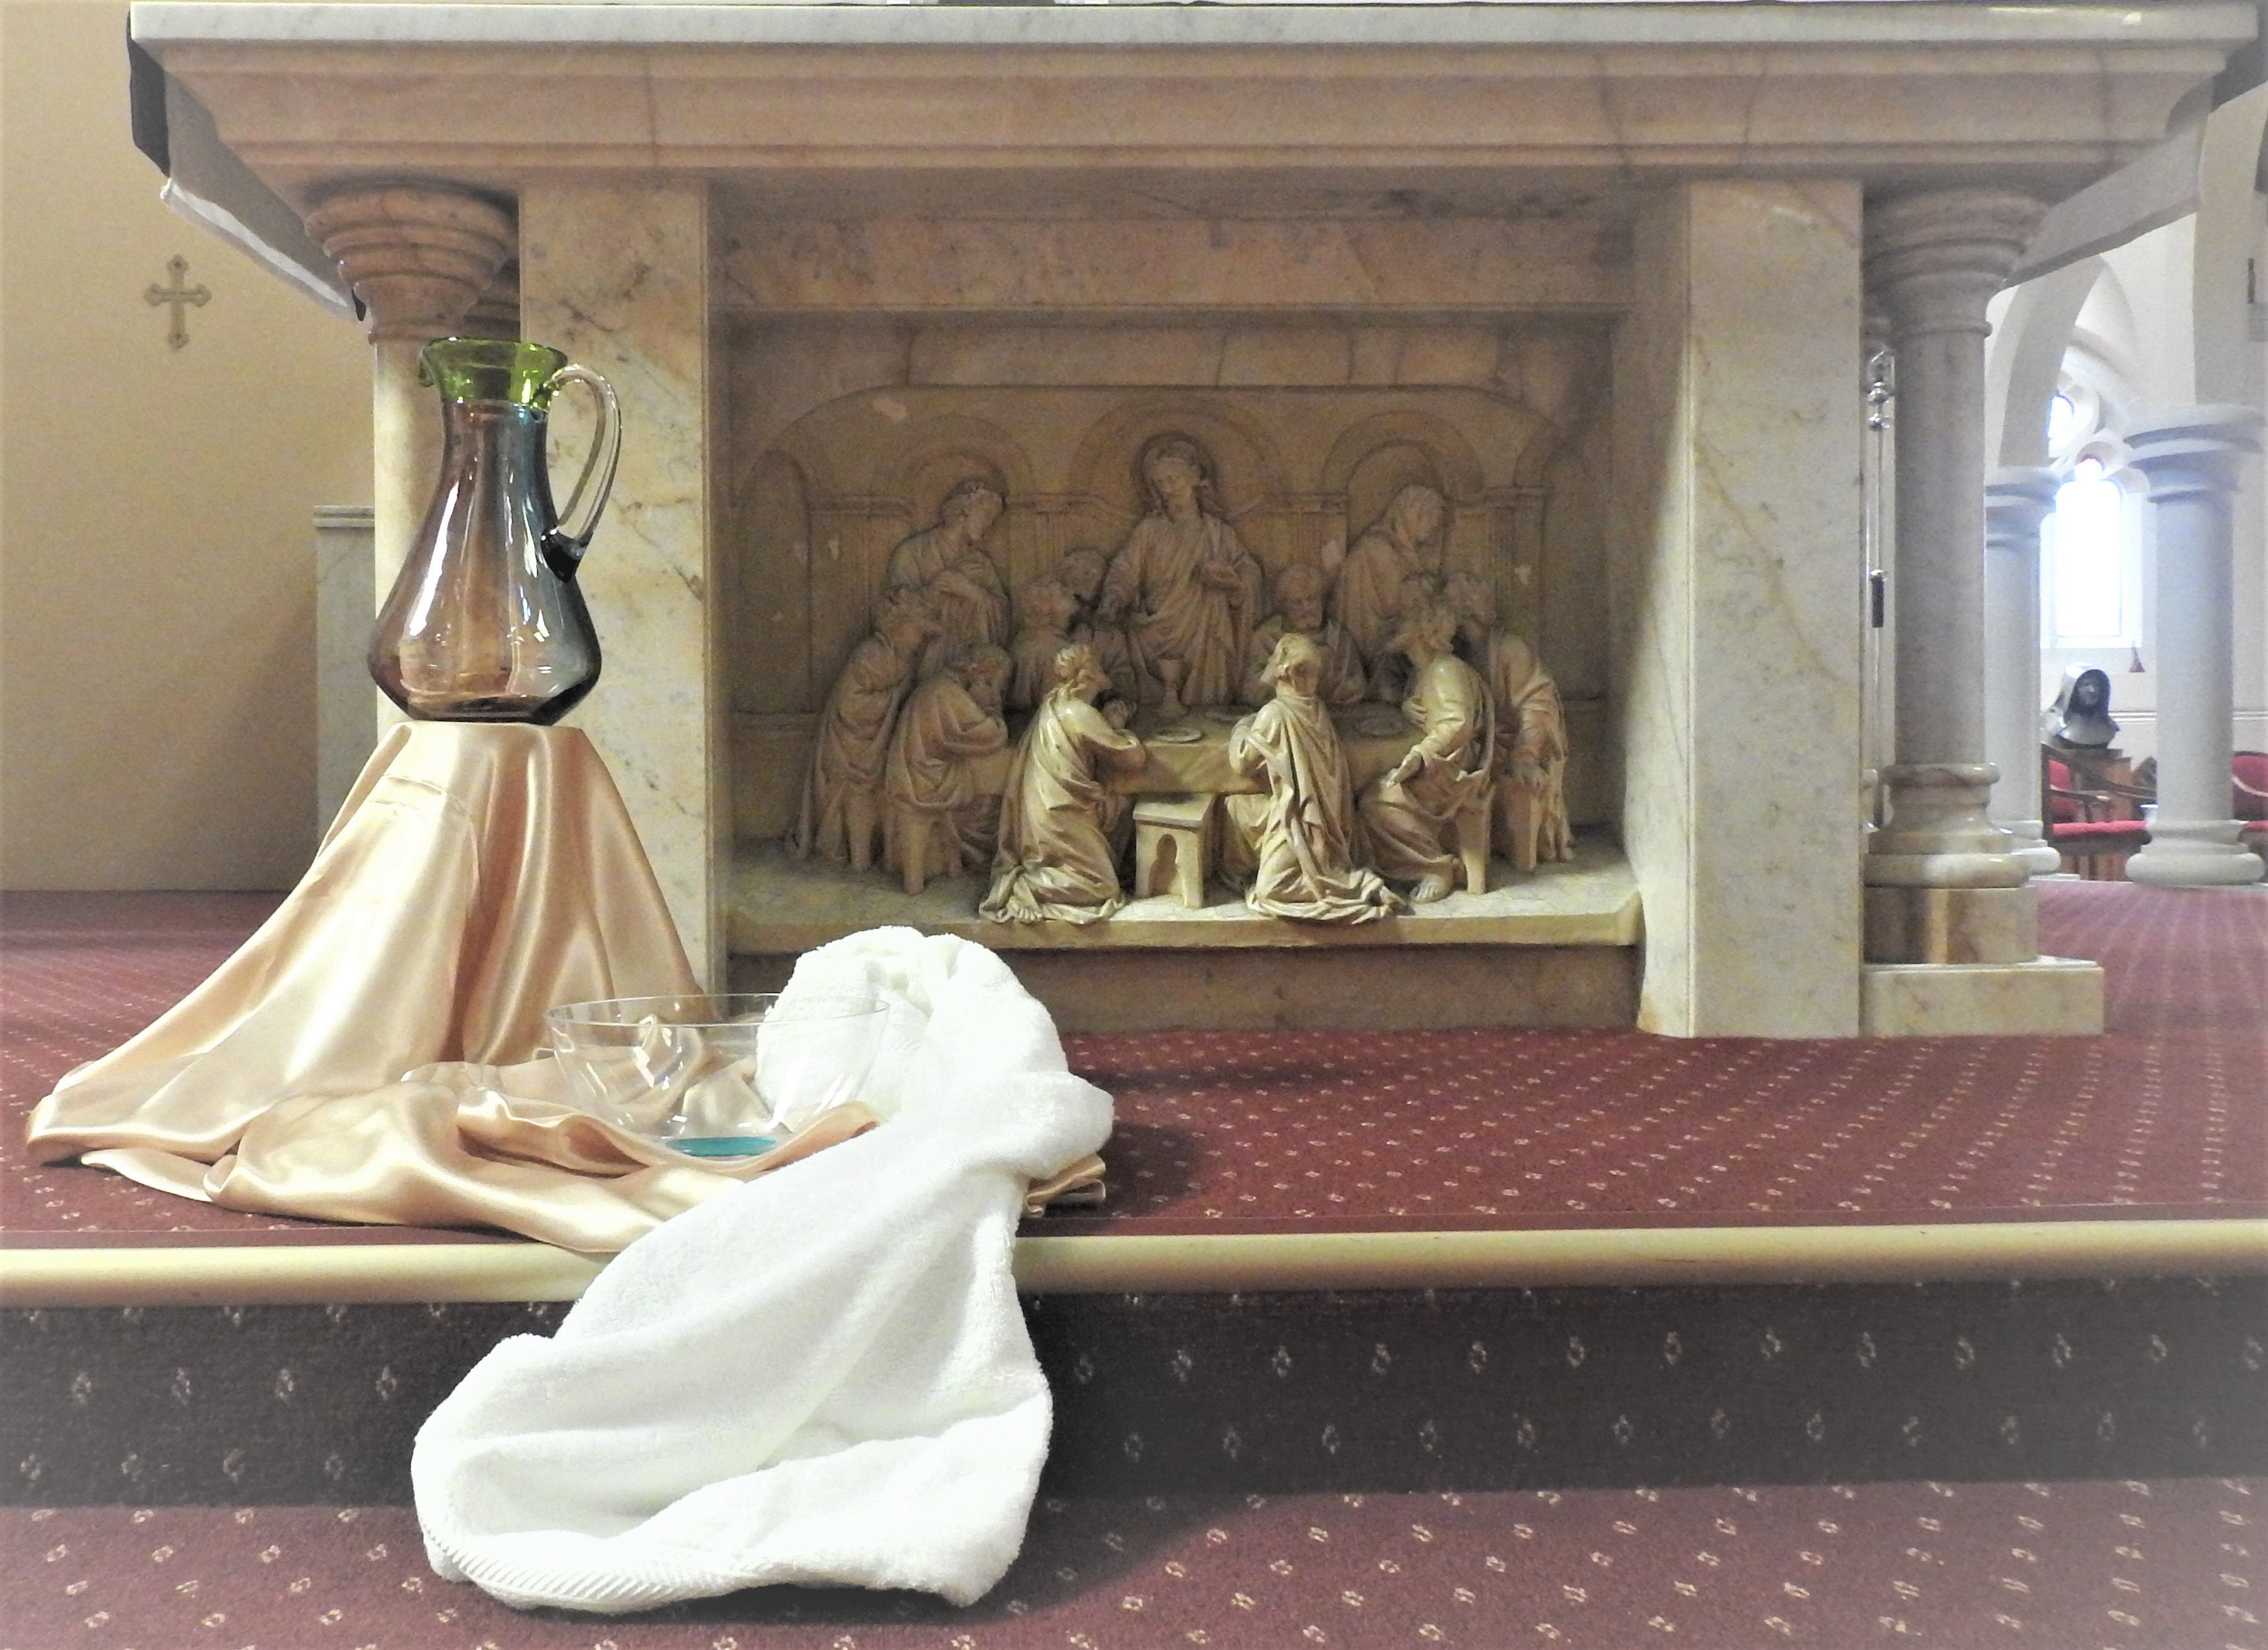
After washing their feet
Jesus asked the disciples,
“Do you understand
what I have done to you?”
Place yourself
in this room with Jesus
and he is washing your feet.
What is your response
to his question?

Slide 8
Then Jesus says to his disciples,
“I have washed your feet,
you should wash
each others feet.
I have given you an example
so that you may copy
what I have done to you.
Are you willing
to follow Jesus example?

Slide 9
Will you take up a bowl and a towel,
kneel humbly
and wash the feet of another?
Will you take up the servant’s role?
Whose feet will you wash?

Slide 10
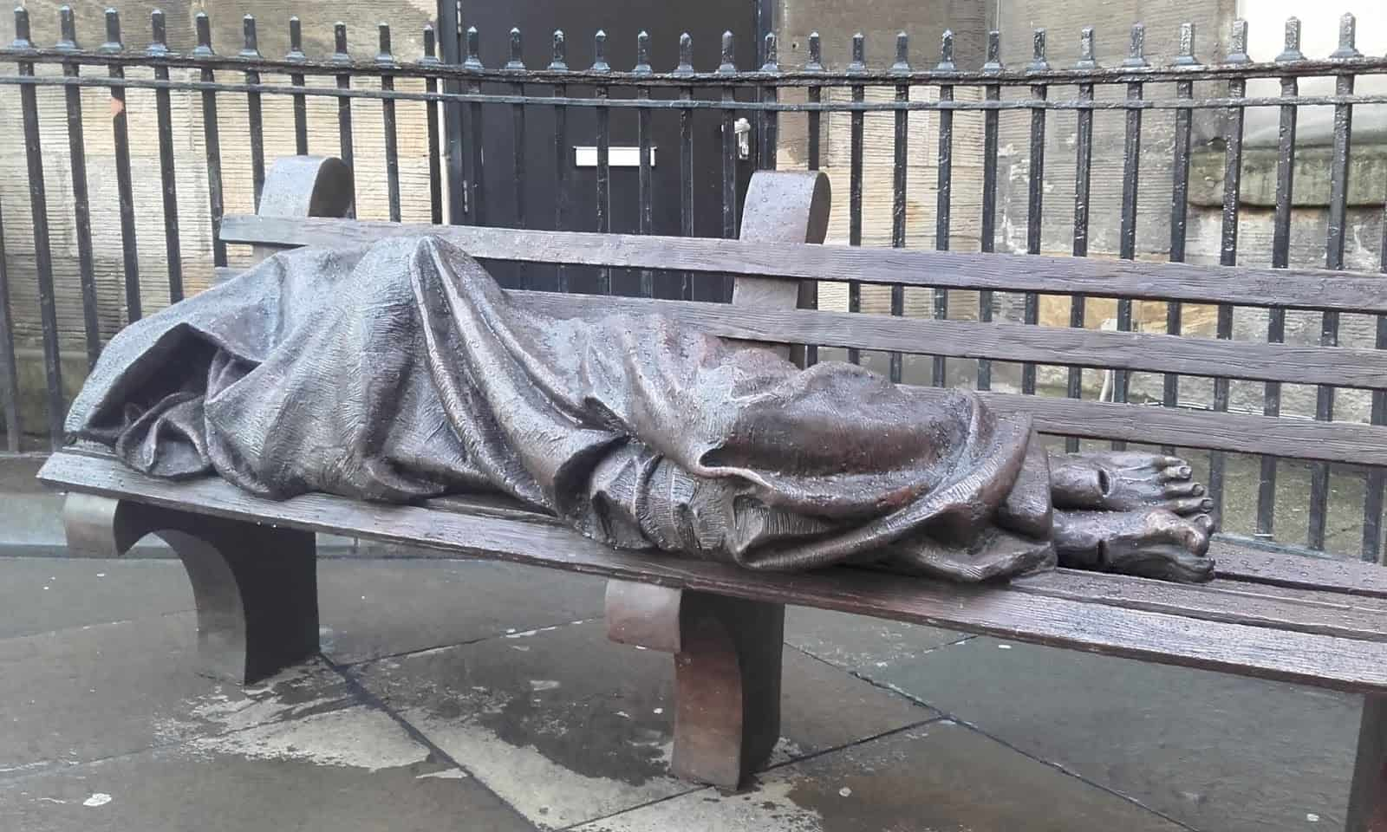
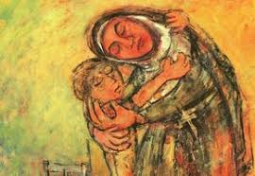
Bountiful and loving God,
You have filled the heart of Mary MacKillop
with compassionate love for those
who are in need at the margins of our society.
Deepen that love within us
that we may embrace the mystery of the Cross
which leads us through death to life.
We ask this in the Spirit of Jesus
who having broken the bonds of death
leads us to everlasting life. Amen.
Monica Cavanagh rsj in Mary MacKillop – A Window of Hope

Slide 11
This is my Body
given for you.
This is my life Blood poured out for you.
We embrace God’s mission.
Let us seek first the poorest, most neglected parts
of God’s vineyard.
Mary MacKillop 6th March 1900 (adapted)

