Slide 1
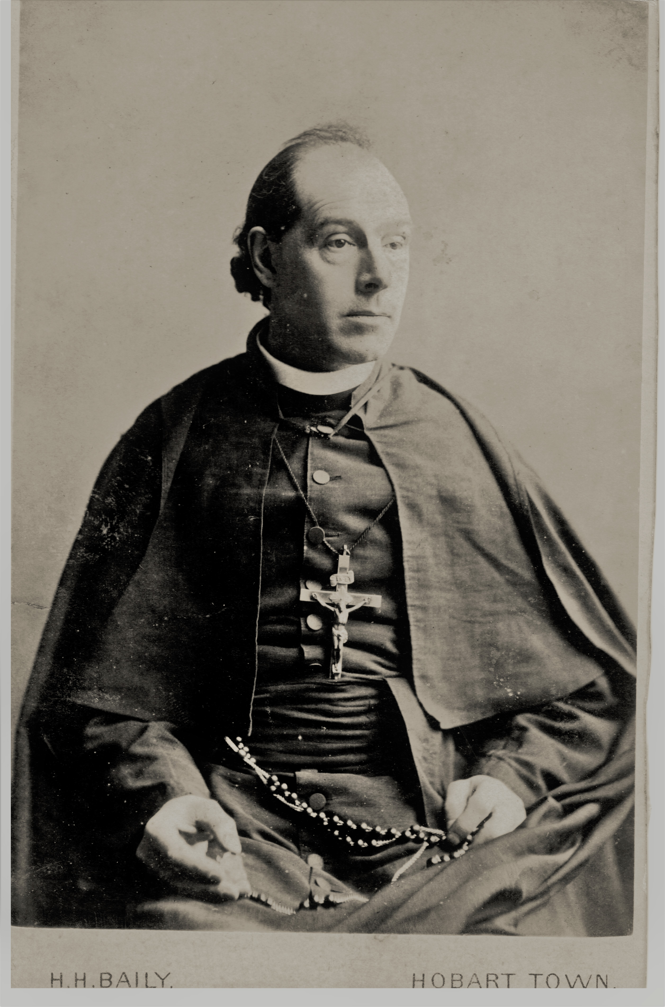
FR JULIAN TENISON WOODS
Sisters of Saint Joseph Congregational Archives
MODULE INTRODUCTION VIDEO
Click Here
© MARY MACKILLOP PLACE MUSEUM 2021

Slide 2
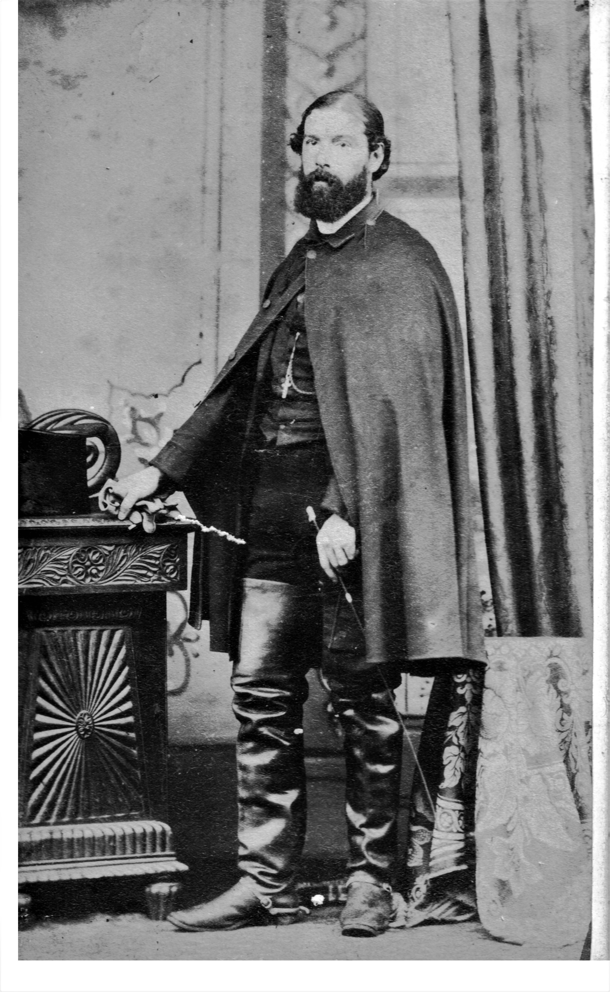
JULIAN TENISON WOODS:MISSION LIFE IN THE EARLY SETTLEMENTS
Sisters of Saint Joseph Congregational Archives

Slide 3
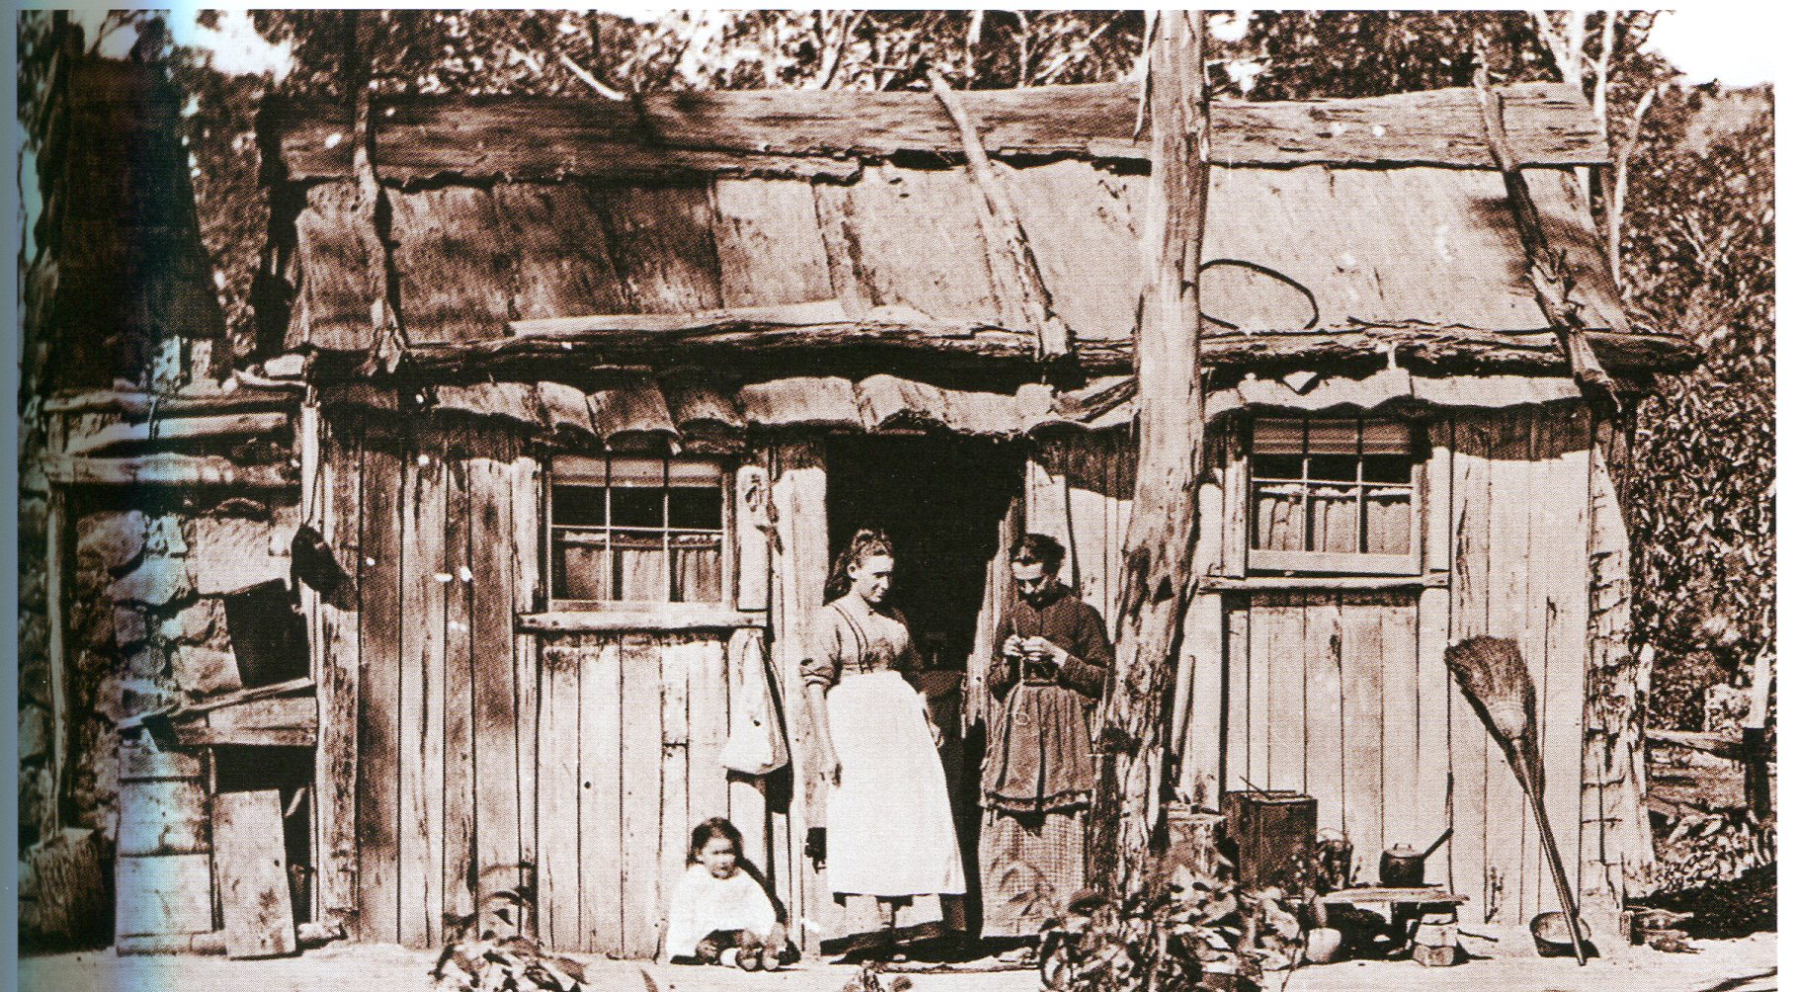
Miners' cottage - slab and bark dwelling, South Australia 1880s

Slide 4
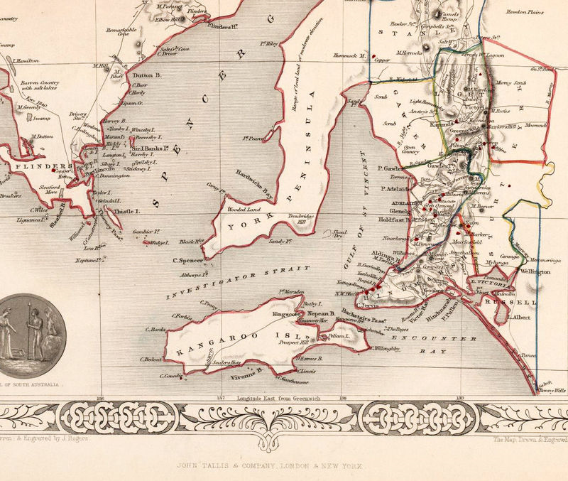
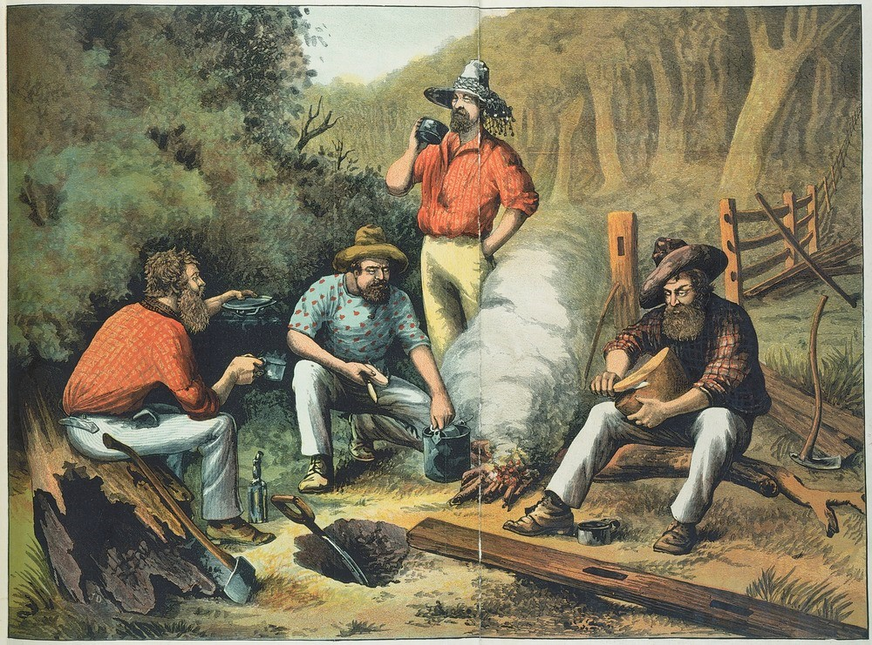
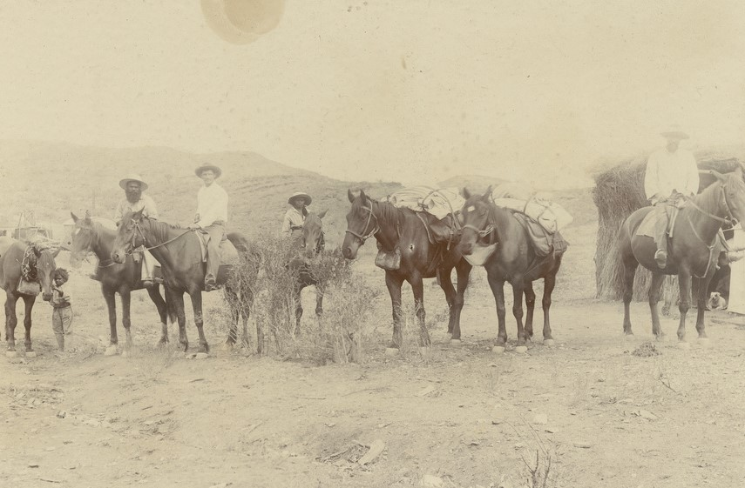
FR JULIAN ON THE MOVE –BUSH CAMPING
56,000 square miles to cover on horseback.

Slide 5
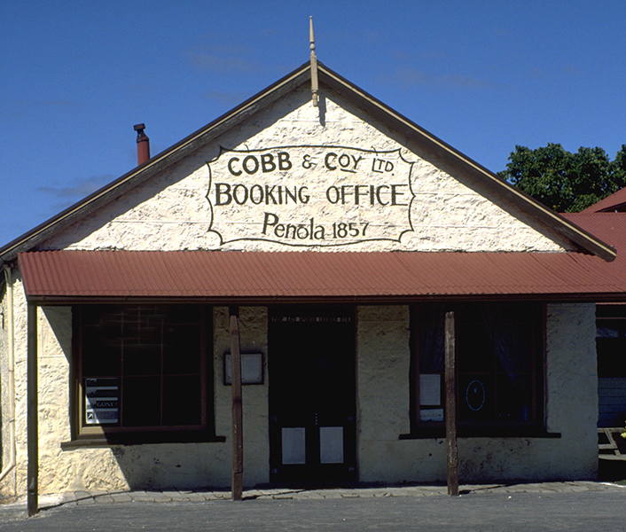
PENOLA
The central location in the events and life of Mary MacKillop [St. Mary of the Cross ] and Fr Julian T Woods
Image courtesy of Edwina Huntley

Slide 6
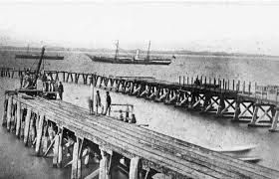
ROBE
Port Robe,1870
St Mary's Star of the Sea Church

Slide 7
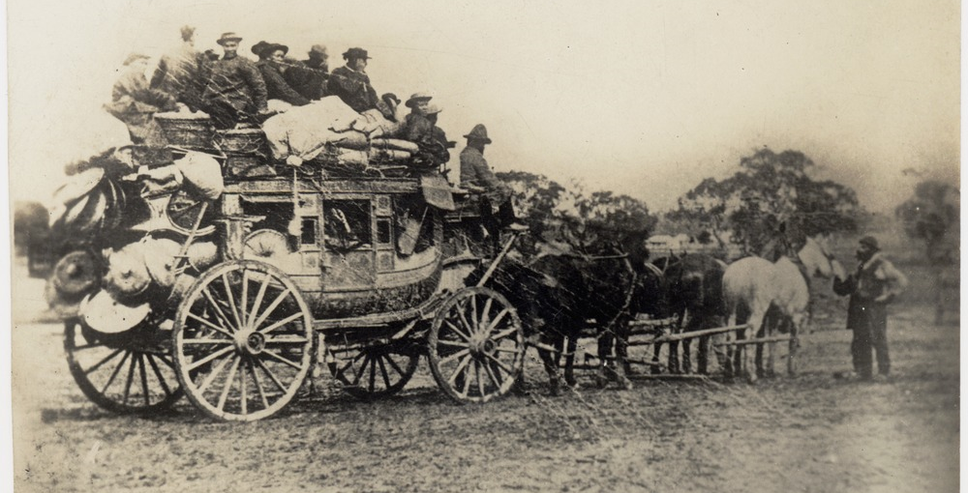
Chinese miners on board a Cobb & Co coach to the Goldfields 1858

Slide 8
TODAY WE WILL EXPLORE THE MUSEUM’S COLLECTION
What do we learn by looking at objects that tell us about South Australia in the 1850 - 70s?
What do the three objects presented in the videos all have in common in our story?
What do they tell us about the person of Fr Julian Woods and his life experiences?

Slide 9
OBJECT BASED LEARNING VIDEO
Mary MacKillop Place Museum collection
AN INTRODUCTION
Click here

Slide 10
OBJECT BASED LEARNING – VIDEO 2
AN OBJECT FOR BUSH CAMPING & FIRST AID IN COLONIAL TIMES
Click Here

Slide 11
OBJECT BASED LEARNING – VIDEO 3
AN OBJECT BUILT FOR TRAVEL
Click Here

Slide 12
OBJECT BASED LEARNING – VIDEO 4
AN OBJECT OF PERSONAL DEVOTION
Click Here

Slide 13
VIDEO CONCLUSION
Click Here

